Slide 1
Associative Memory

Slide 2
Associative Memory
A memory unit accessed by content is called an associative memory or content addressable memory (CAM).
This type of memory is accessed simultaneously and in parallel on the basis of data content rather than by specific address or location.
The time required to find an item stored in memory can be reduced considerably if stored data can be identified for access by the content of the data itself rather than by an address.
When a word is written in an associative memory, no address is given.

Slide 3
Associative Memory
When a word is to be read from an associative memory, the content of the word, or part of the word, is specified.
The memory locates all words which match the specified content and marks them for reading.
An associative memory is more expensive than a RAM because each cell must have storage capability as well as logic circuits for matching its content with an external argument.
For this reason, associative memories are used in applications where the search time is very critical and must be very short.

Slide 4
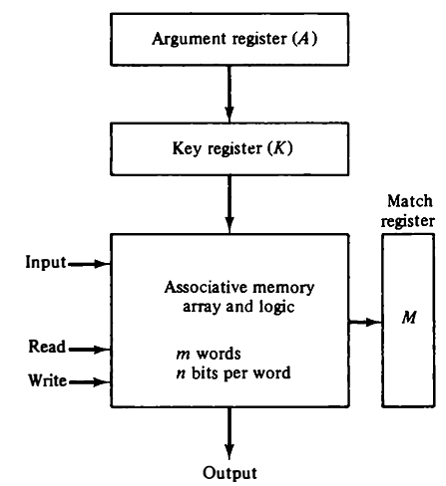
Associative Memory
The block diagram of an associative memory is shown in Fig. consists of a memory array and logic for m words with n bits per word.
The argument register A and key register K each have n bits, one for each bit of a word.
The match register M has m bits, one for each memory word.
Fig: Block diagram of associative memory.

Slide 5
Associative Memory
Each word in memory is compared in parallel with the content of the argument register.
The words that match the bits of the argument register set a corresponding bit in the match register.
After the matching process, those bits in the match register that have been set indicate the fact that their corresponding words have been matched.
Fig: Block diagram of associative memory.

Slide 6
Associative Memory
The key register provides a mask for choosing a particular field or key in the argument word.
The entire argument is compared with each memory word if the key register contains all 1's.
Otherwise, only those bits in the argument that have 1's in their corresponding position of the key register are compared.
Fig: Block diagram of associative memory.

Slide 7
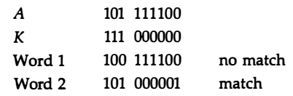
Associative Memory
For example, suppose that the argument register A and the key register K have the bit configuration shown below.
Only the three leftmost bits of A are compared with memory words because K has 1's in these positions.
Fig: Block diagram of associative memory.

Slide 8
Associative Memory
Reading is accomplished by a sequential access to memory for those words whose corresponding bits in the match register have been set.
Fig: Block diagram of associative memory.

Slide 9
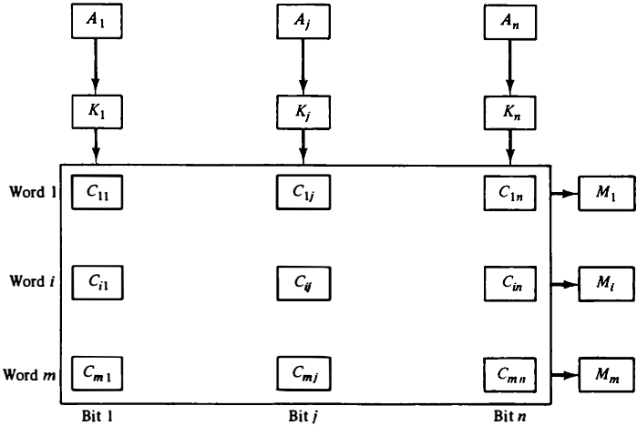
Associative Memory
The relation between the memory array and external registers in an associative memory is shown in Fig.
The cells in the array are marked by the letter C with two subscripts. The first subscript gives the word number and the second specifies the bit position in the word.
Fig: Associative memory of m word, n cells per word

Slide 10
Associative Memory
The cell C_{ij} is the cell for bit j in word i. A bit A_{j} in the argument register is compared with all the bits in column j of the array provided that K_{j} = 1. This is done for all columns j = 1, 2, . . . , n.
Fig: Associative memory of m word, n cells per word

Slide 11
Associative Memory
If a match occurs between all the unmasked bits of the argument and the bits in word i, the corresponding bit M₁ in the match register is set to 1.
If one or more unmasked bits of the argument and the word do not match, M₁ is cleared to 0.
Fig: Associative memory of m word, n cells per word

Slide 12
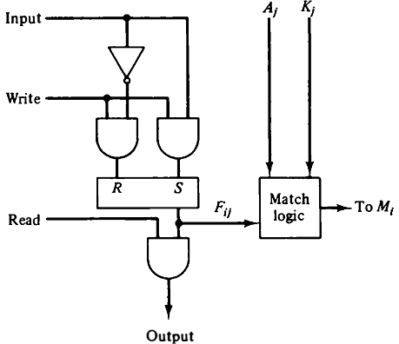
Associative Memory
The internal organization of a typical cell C_{ij} is shown in Fig.
It consists of a flip-flop storage element F_{ij} and the circuits for reading, writing, and matching the cell.
The input bit is transferred into the storage cell during a write operation.
Fig: One cell of associative memory

Slide 13
Associative Memory
The bit stored is read out during a read operation.
The match logic compares the content of the storage cell with the corresponding unmasked bit of the argument and provides an output for the decision logic that sets the bit in M_{i}.
Fig: One cell of associative memory

Slide 14

Associative Memory
The match logic for each word can be derived from the comparison algorithm for two binary numbers.
First, we neglect the key bits and compare the argument in A with the bits stored in the cells of the words.
Word i is equal to the argument in A if A_{i} = F_{ij} for j = 1, 2, . . . , n .
Two bits are equal if they are both 1 or both 0.
The equality of two bits can be expressed logically by the Boolean function
where x_{j} = 1 if the pair of bits in position j are equal; otherwise, x_{j} = 0.

Slide 15

Associative Memory
For a word i to be equal to the argument in A we must have all x_{j} variables equal to 1.
This is the condition for setting the corresponding match bit M, to 1.
The Boolean function for this condition is

Slide 16

Associative Memory
We now include the key bit K_{j} in the comparison logic.
The requirement is that if K_{j} = 0, the corresponding bits of A_{j} and F_{ij} need no comparison.
Only when K_{j} = 1 must they be compared. This requirement is achieved by ORing each term with K’_{j} thus:
When K_{j} = 1, we have K’_{j} = 0 and x_{j} + 0 = x_{j} .
When K_{j} = 0, then K’_{j} = 1 and x_{j} + 1 = 1.
A term (x_{j} + K’_{j}) will be in the 1 state if its pair of bits is not compared.

Slide 17
Associative Memory
The match logic for word i in an associative memory can now be expressed by the following Boolean function:
Each term in the expression will be equal to 1 if its corresponding K_{j} = 0.
If K_{j} = 1, the term will be either 0 or 1 depending on the value of x_{j}.
A match will occur and M_{i} will be equal to 1 if all terms are equal to 1 .

Slide 18

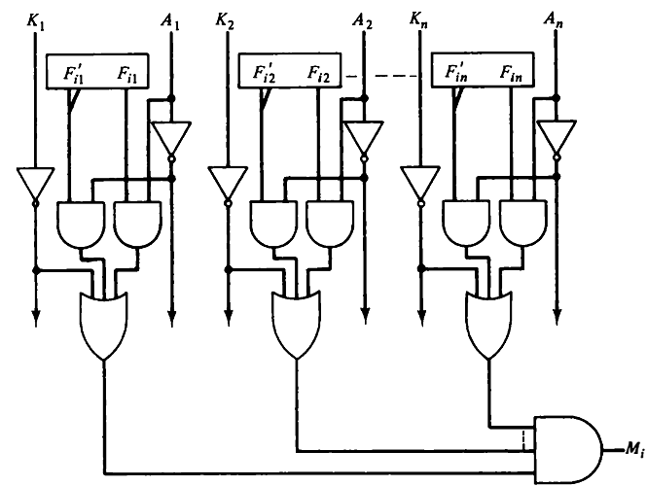
Associative Memory
If we substitute the original definition of x_{j}, the Boolean function can be expressed as follows:

Slide 19
Associative Memory
READ Operation:
If more than one word in memory matches the unmasked argument field, all the matched words will have 1's in the corresponding bit position of the match register.
It is then necessary to scan the bits of the match register one at a time.
The matched words are read in sequence by applying a read signal to each word line whose corresponding M, bit is a 1.

Slide 20
Associative Memory
READ Operation:
In most applications, the associative memory stores a table with no two identical items under a given key.
In this case, only one word may match the unmasked argument field.
By connecting output M_{i} directly to the read line in the same word position (instead of the M register)
The content of the matched word will be presented automatically at the output lines and no special read command signal is needed.

Slide 21
Associative Memory
WRITE Operation:
An associative memory must have a write capability for storing the information to be searched.
Writing in an associative memory can take different forms, depending on the application.
If unwanted words have to be deleted and new words inserted one at a time, there is a need for a special register to distinguish between active and inactive words.
This register, sometimes called a tag register, would have as many bits as there are words in the memory.
For every active word stored in memory, the corresponding bit in the tag register is set to 1.

Slide 22
Associative Memory
WRITE Operation:
A word is deleted from memory by clearing its tag bit to 0.
Words are stored in memory by scanning the tag register until the first 0 bit is encountered.
This gives the first available inactive word and a position for writing a new word.

